Slide 1
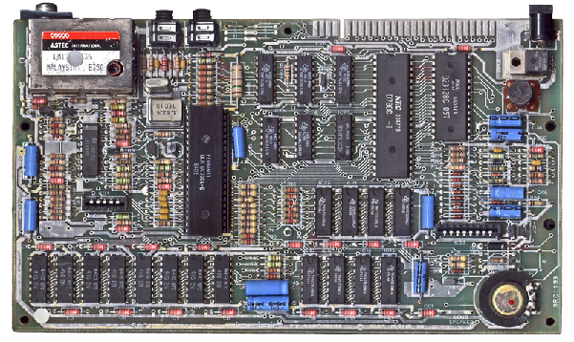

ENGR 151
An (accelerated) introduction to computers and programming
Lecture 5 - MATLAB: Statistics, interpolation and curve fitting

Slide 2
Recap
1D plot (line, scatter, histogram)
when to use log scale
what does histogram represent
2D plot (contour, image, surface)
how to create 2-D (x-y) coordinate matrices
use logical indexing for plotting

Slide 3
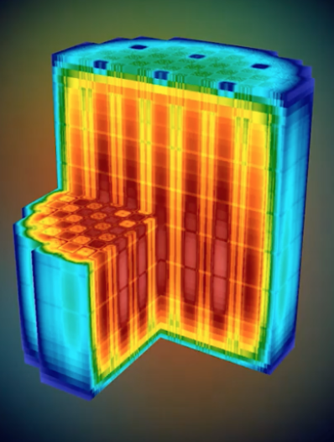
2D vs 3D plot
Surface plot (quasi-3D)
z = f(x,y)
3D plot
F = f(x,y,z)
Notes:
z=f(x,y)
Color enhance your visualization but provides duplicate information

Slide 4
Contents
Basic Statistics
Data Smoothing and Least Square Fitting
Interpolation
cftool
Notes:
Array store the data
Visualize data
Inteprete data

Slide 5
Today
Statistics basics
mean, mode, median, var, std
Smoothing
smooth
Curve fitting
linear regression, polyfit, polyval, roots
curve fitting toolbox
Interpolation
interp1

Slide 6
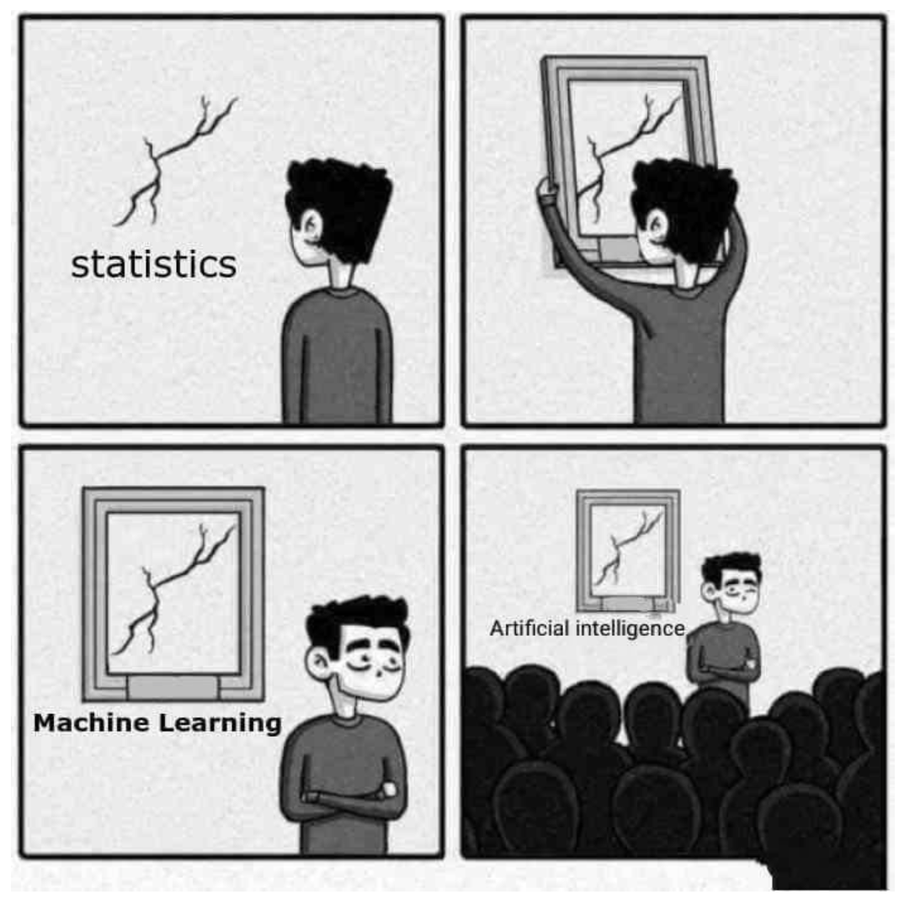

Slide 7
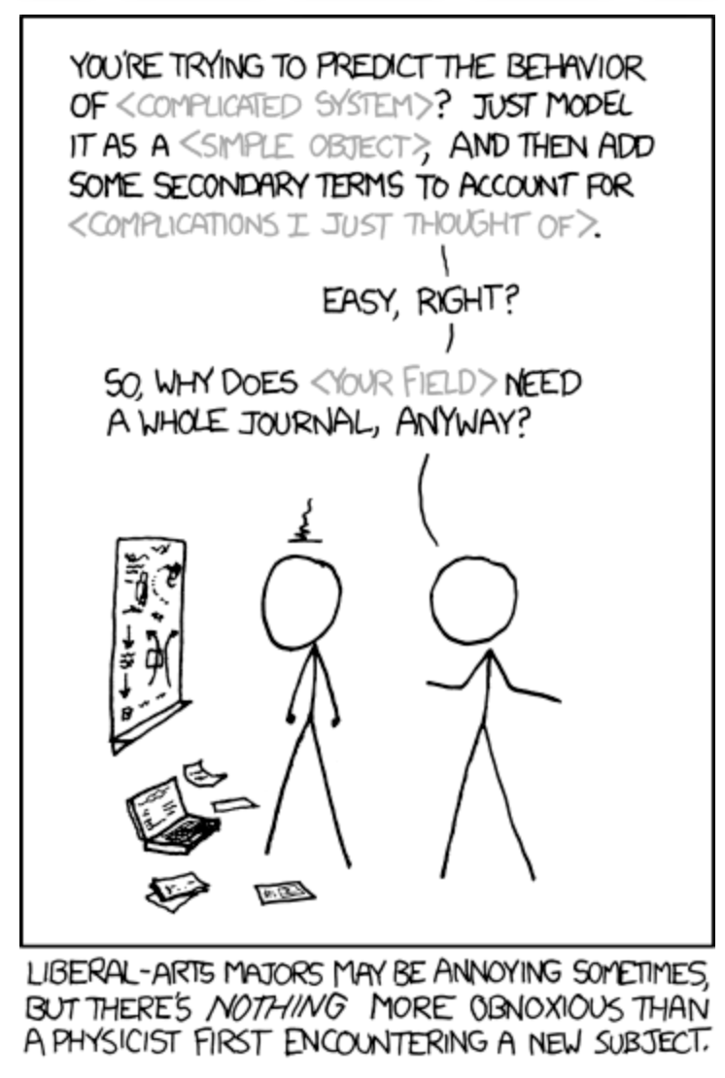
(XKCD)

Slide 8
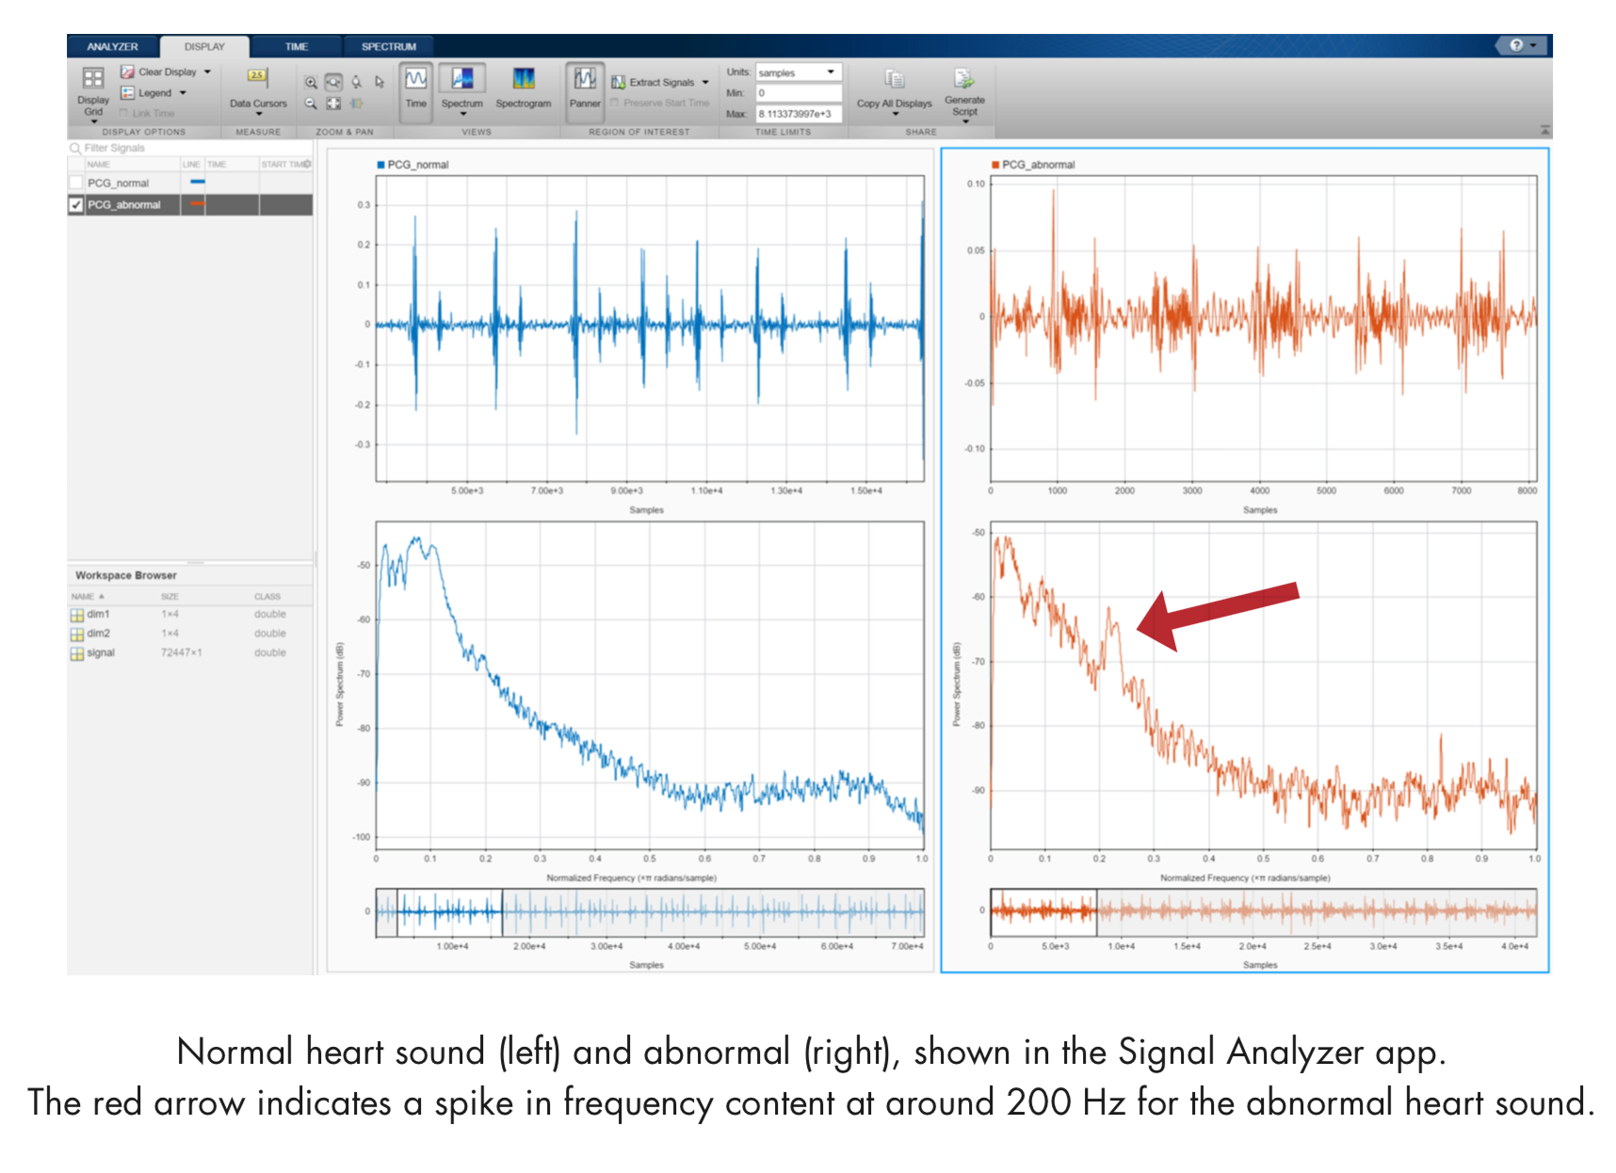
Mathworks machine learning example
Look for abnormal frequency in the heartbeat

Slide 9
Statistics
Statistics is the area of mathematics concerned with understanding and interpreting (real world) data
Data are usually scattered due to noise / fluctuations when measured from the real world or have numerical errors in simulations
Data analysis often involves trying to find an underlying trend that may be used to make predictions (machine learning)
Notes:
Statistics / ML: ML is based on statistics
statistics: inference of data ML: prediction
This lecture is by no means to provide a thorough statistics perspective
We just get our hands a bit wet on playing some statistic techniques with Matlab

Slide 10
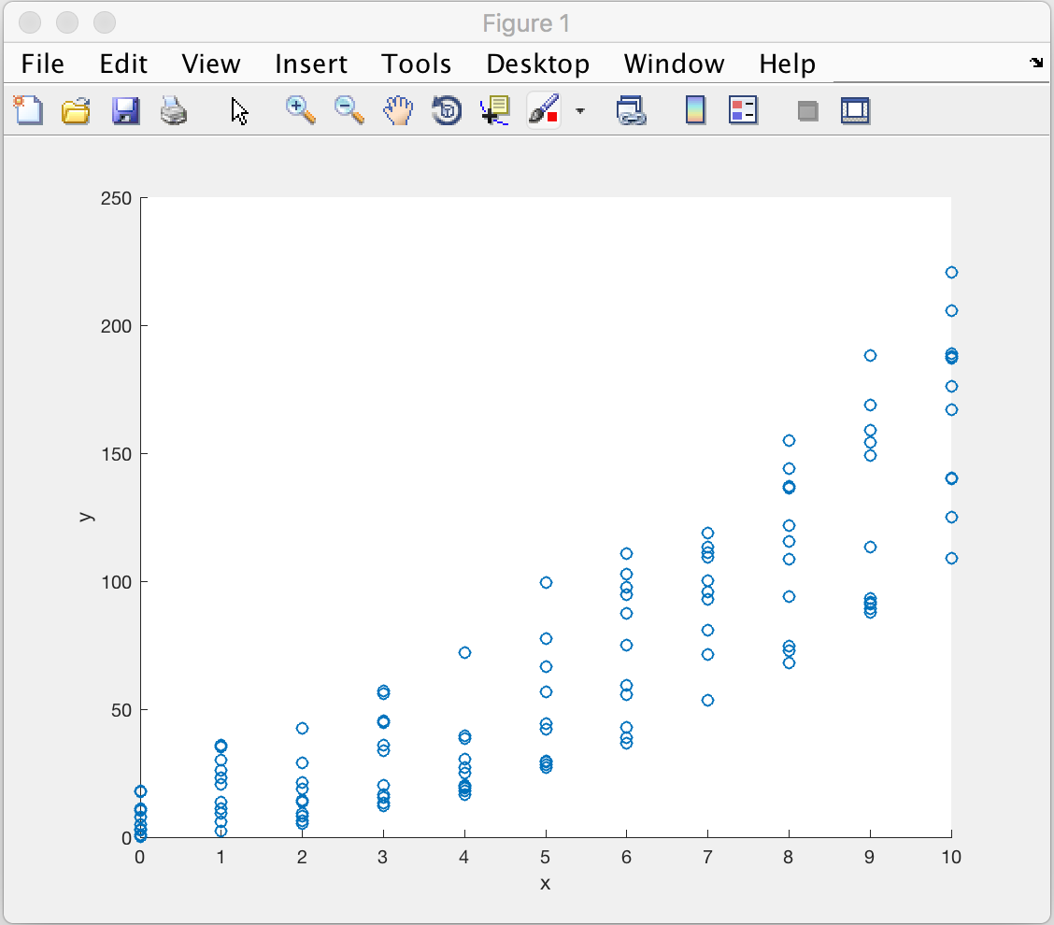
A scatter plot from last lecture
Notes:
Fluctuation of side effect of each dose
How to quantify this?
a. fluctuation
b. trend

Slide 11
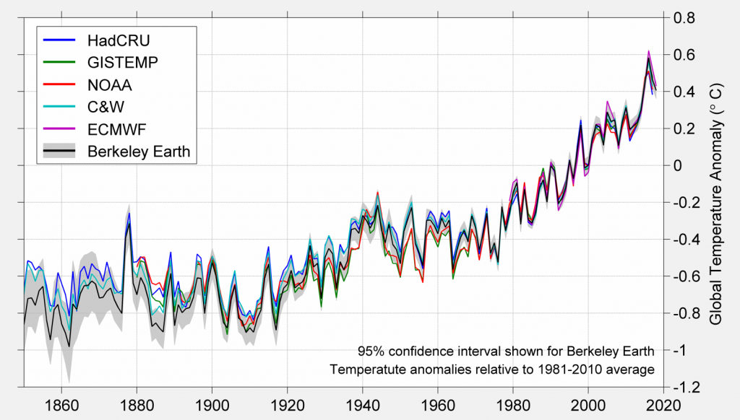
Real data with fluctuations: Temperature of the earth

Slide 12
Review of basic concepts
For a collection of N data, labelled $x_{i}$ the arithmetic mean is $\overline{x}=\frac{1}{N}\overset{N}{\underset{i=1}{∑}}x_{i}$
This is a measure of the average properties of the data
In MATLAB mean(x) gives the arithmetic mean
mode(x) and median(x) give the most common value and the middle value in a sequence of data, respectively
Notes:
demo x=[1,1,2,4,7]

Slide 13
Review of basic concepts
The variance $V$ and standard deviation $σ$ give a measure of the spread in values about the mean
The variance (var(x) in MATLAB) is $V=\frac{1}{N-1}\overset{N}{\underset{i=1}{∑}}(x_{i}-\overline{x})^{2}$
If values are close to $\overline{x}$, then $V→0$
The standard deviation, $σ=\sqrt{V}$ (std(x) in MATLAB), is a measure of the width of the distribution of data
Notes:
N-1 is not intuitive (unbiased estimation of the true variance)
demo: x = [0 10 20 30 40] or [18 19 20 21 22]

Slide 14
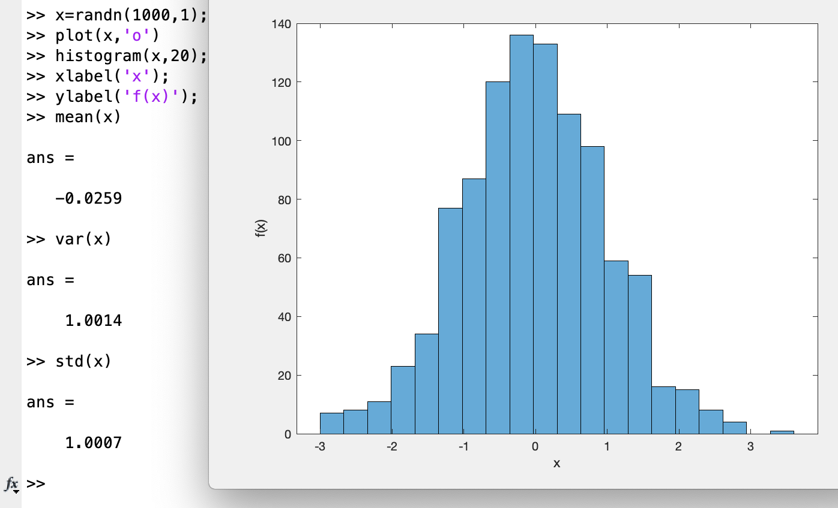
mean, var, std

Slide 15
Add statistics / other toolboxes using Add-Ons
Search for “statistics and machine learning toolbox” and install it
You will need the credentials you used to install MATLAB
Notes:
demo add-ons
12:15

Slide 16
Contents
Basic Statistics
Data Smoothing and Least Square Fitting
Interpolation
cftool
Notes:
Smoothing is to give a general idea of relatively slow changes of value
Curve fitting concentrates on achieving as close a match as possible

Slide 17
smooth
One way to remove fluctuations and extract the underlying trend is to use smoothing (or filtering)
Smoothing involves taking an average over adjacent points to remove small scale fluctuations
In MATLAB: B = smoothdata(A) B = smoothdata(A,dim) B = smoothdata(___,method) B = smoothdata(___,method,window)
window is number of points to average over, default method is “movmean” - a moving average over number of points
Notes:
Check with next slide first
movmean: moving average over each window of A
larger window -> flatter results

Slide 18
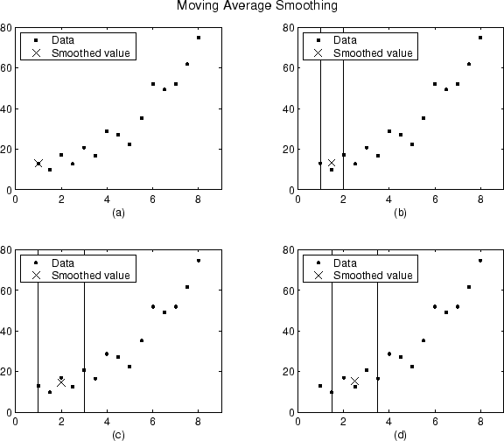
Moving average
Notes:
no left neighbor, 1 left and 1 right, 2 left and 2 right
window size = 5

Slide 19
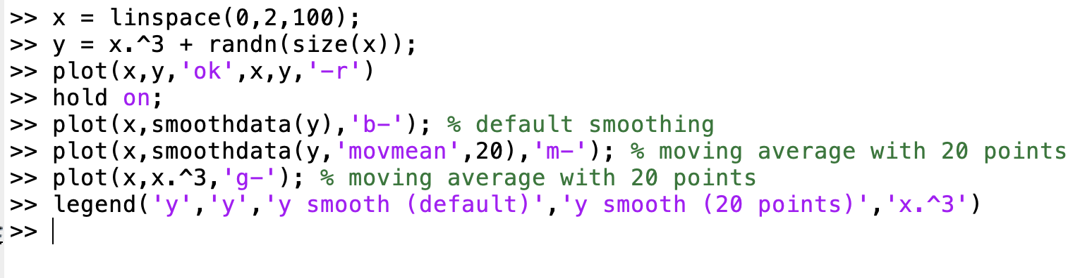
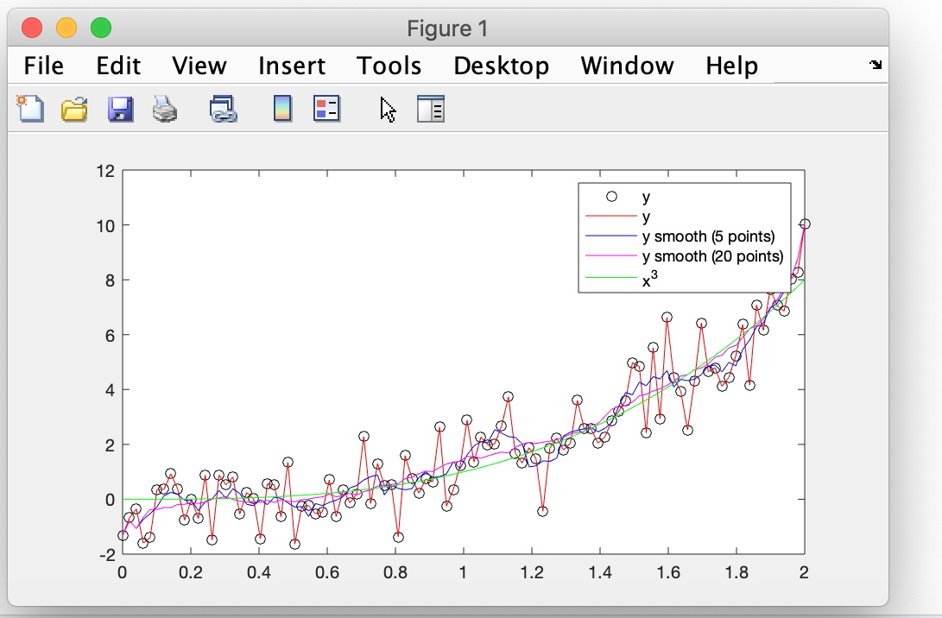
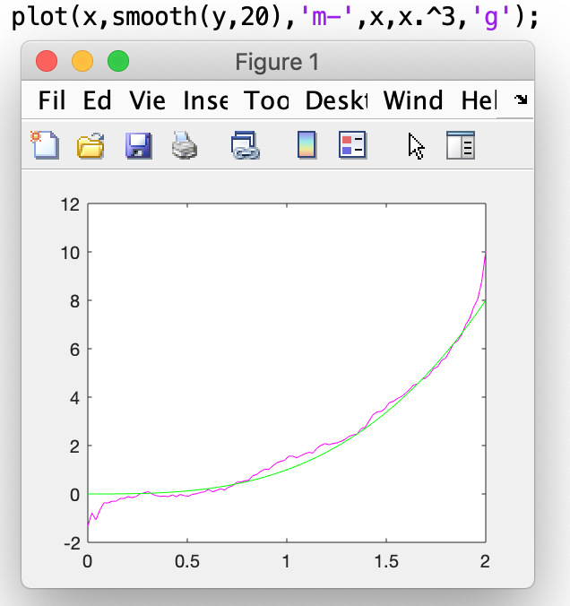
Moving average of our data
Notes:
demo

Slide 20
Challenge
Find lecture_5_data.mat in canvas (Files/Matlab_files)
Contains a dataset x1,y1
Create smoothed data curve from y1 and plot over scatter plot of (x1,y1)
Using smoothdata(y1, “movmean”, np)
Notes:
12:40

Slide 21
Model based fitting
As an alternative to smoothing data to extract an underlying trend, we can fit a model to the data
A model is a mathematical expression describing the assumed relationship held between a dependent variable $y$ and independent variable $x$ (or variables $x_{0},x_{1},x_{2}…$)
If the fit is good (as measured by, e.g. the least squares) we may use the model to make predictions
Notes:
assumed model that largely represent the trend of data

Slide 22
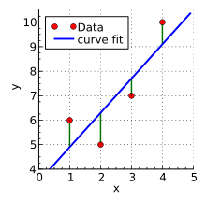
Least squares
If I have datasets $x_{i}$ and $y_{i}$ with N points and a model $y=f(x)$ then the residuals are $r_{i}=y_{i}-f(x_{i})$
and the sum of squared residuals is $S=\overset{N}{\underset{i=1}{∑}}r_{i}^{2}$
The least squares fit is the function f which minimizes S, i.e.has all the data points closest to the model curve on average
(Wikipedia)
Notes:
residual could be positive or negative (square of the residual - square of the amplitude of the deviation from data)

Slide 23
Review: R-squared
We can characterize a fit by its “R-squared” value, which is a measure of how well the data are reproduced by the model: $R^{2}=1-\frac{\sum_{i=1}^{N}{r_{i}^{2}}}{∑_{i=1}^{N}(y_{i}-\overline{y})^{2}}$
“worst” fitting $f(x)=\overline{y}$
$$r_{i}^{2}=(y_{i}-\overline{y})^{2}$$
R² is generally between 0 and 1 with 1 meaning variation in data is completely explained by the model
Notes:
want r^2 as small as possible, so R^2 is close to 1 means good fitting.

Slide 24
Linear regression
Linear regression involves fitting a linear model $f(x)=a+bx$ to the set of values $y_{i}$ given $x_{i}$
In MATLAB we can solve for linear systems uses various solving techniques to find a least squares solution for a and b
$$a+bx_{1}=y_{1}$$
$$a+bx_{2}=y_{2}$$
$$a+bx_{3}=y_{3}$$
…

Slide 25
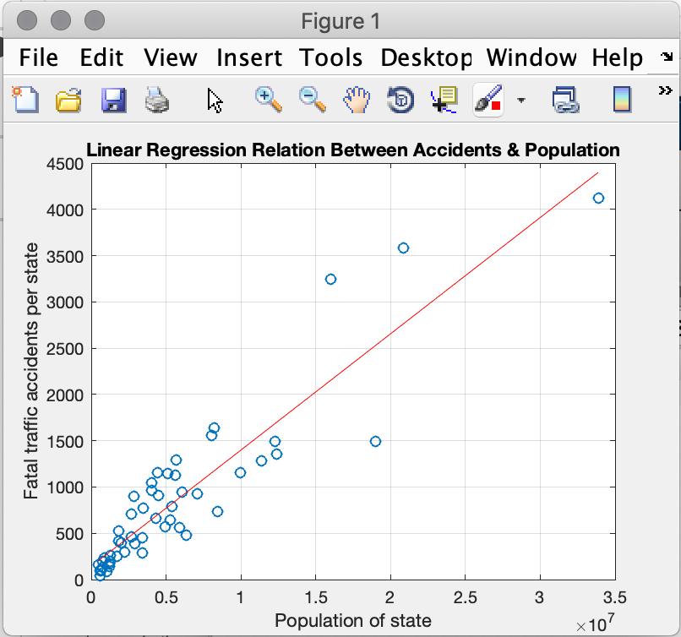
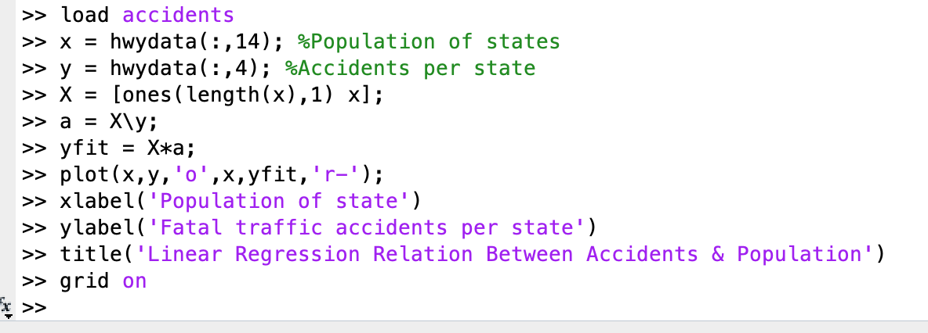
Linear regression
Notes:
Not required.

Slide 26
polyval
y = polyval(p,x)
p is a vector of coefficients for
evaluate polynomial p at points x
e.g. plot(x,polyval([1 -2 3],x)) plots the quadratic equation x²-2x+3
Notes:
Evaluate polynomial of P-coefficients at each point of x
demo: y=x^2+1

Slide 27
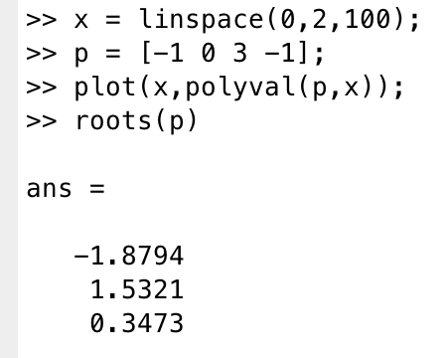
roots
r = roots(p)
returns the roots of the polynomial represented by p as a column vector
e.g. for -x³+3x-1
Notes:
demo: this case
xlim([-2 2])
plot(x,zeros(length(x),1)); to show the zero line

Slide 28
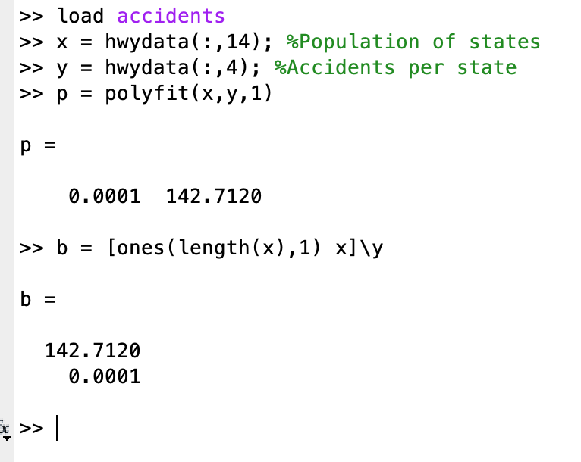
polyfit
p = polyfit(x,y,n)
returns polynomial coefficients for least squares fit to data y of a polynomial in terms of x of degree n
e.g. linear regression would be polyfit(x,y,1)
Notes:
Know polynomials, then how to use it to fit data?

Slide 29
Challenge
Find lecture_5_data.mat in canvas (Lecture data)
Contains a dataset x1,y1
Create polynomial fitting for the first data set x1, y1, and compare it with smoothing
Notes:
demo:
p = polyfit(x1,y1,2)
plot(x1,polyval(p,x1));
talk about smoothing vs fitting
1:05

Slide 30
Takeaways
Smoothing
no function form
need tuning parameter
Curve fitting
explicit function
adjust any number of parameters of the function to obtain ‘best’ fit
Notes:
1:00

Slide 31
Contents
Basic Statistics
Data Smoothing and Least Square Fitting
Interpolation
cftool

Slide 32
Interpolation allows you to find the values in between sampled values by estimating how the underlying function varies
Underlying function
Interpolation
Sample points

Slide 33
Interpolation
Determine the y-value for an x-value between given (x,y) points
(Linear) interpolation:
Assume y values vary with some function (e.g. linearly) between the points
MATLAB interp1 can find new points vq = interp1(x,v,xq) vq = interp1(x,v,xq,method) vq = interp1(x,v,xq,method,extrapolation)
Notes:
Why is it called interp1? 1-D function

Slide 34
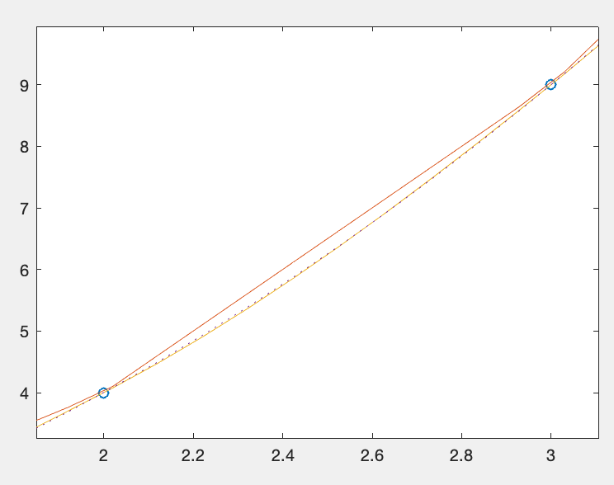
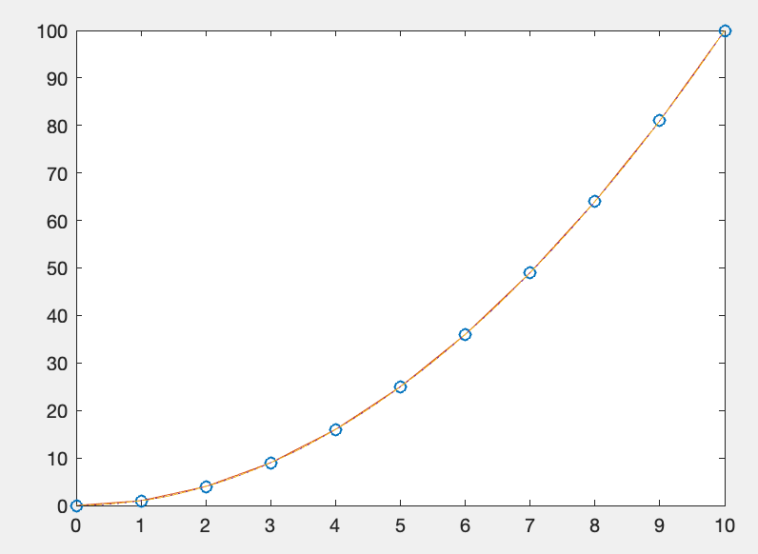
interp1 Example
>> x = 0:10;
>> y = x.^2;
>> xf = linspace(0,10,100);
>> y2 = interp1(x,y,xf,'linear');
>> y3 = interp1(x,y,xf,'pchip');
>> plot(x,y,'o',xf,y2,xf,y3);
linear uses linear interpolation
pchip uses piecewise cubic (third order polynomial between points)
Notes:
demo:
legend(‘data’,’linear’,’pchip’);
zoom in xlim([1,2])

Slide 35
Contents
Basic Statistics
Data Smoothing and Least Square Fitting
Interpolation
cftool

Slide 36
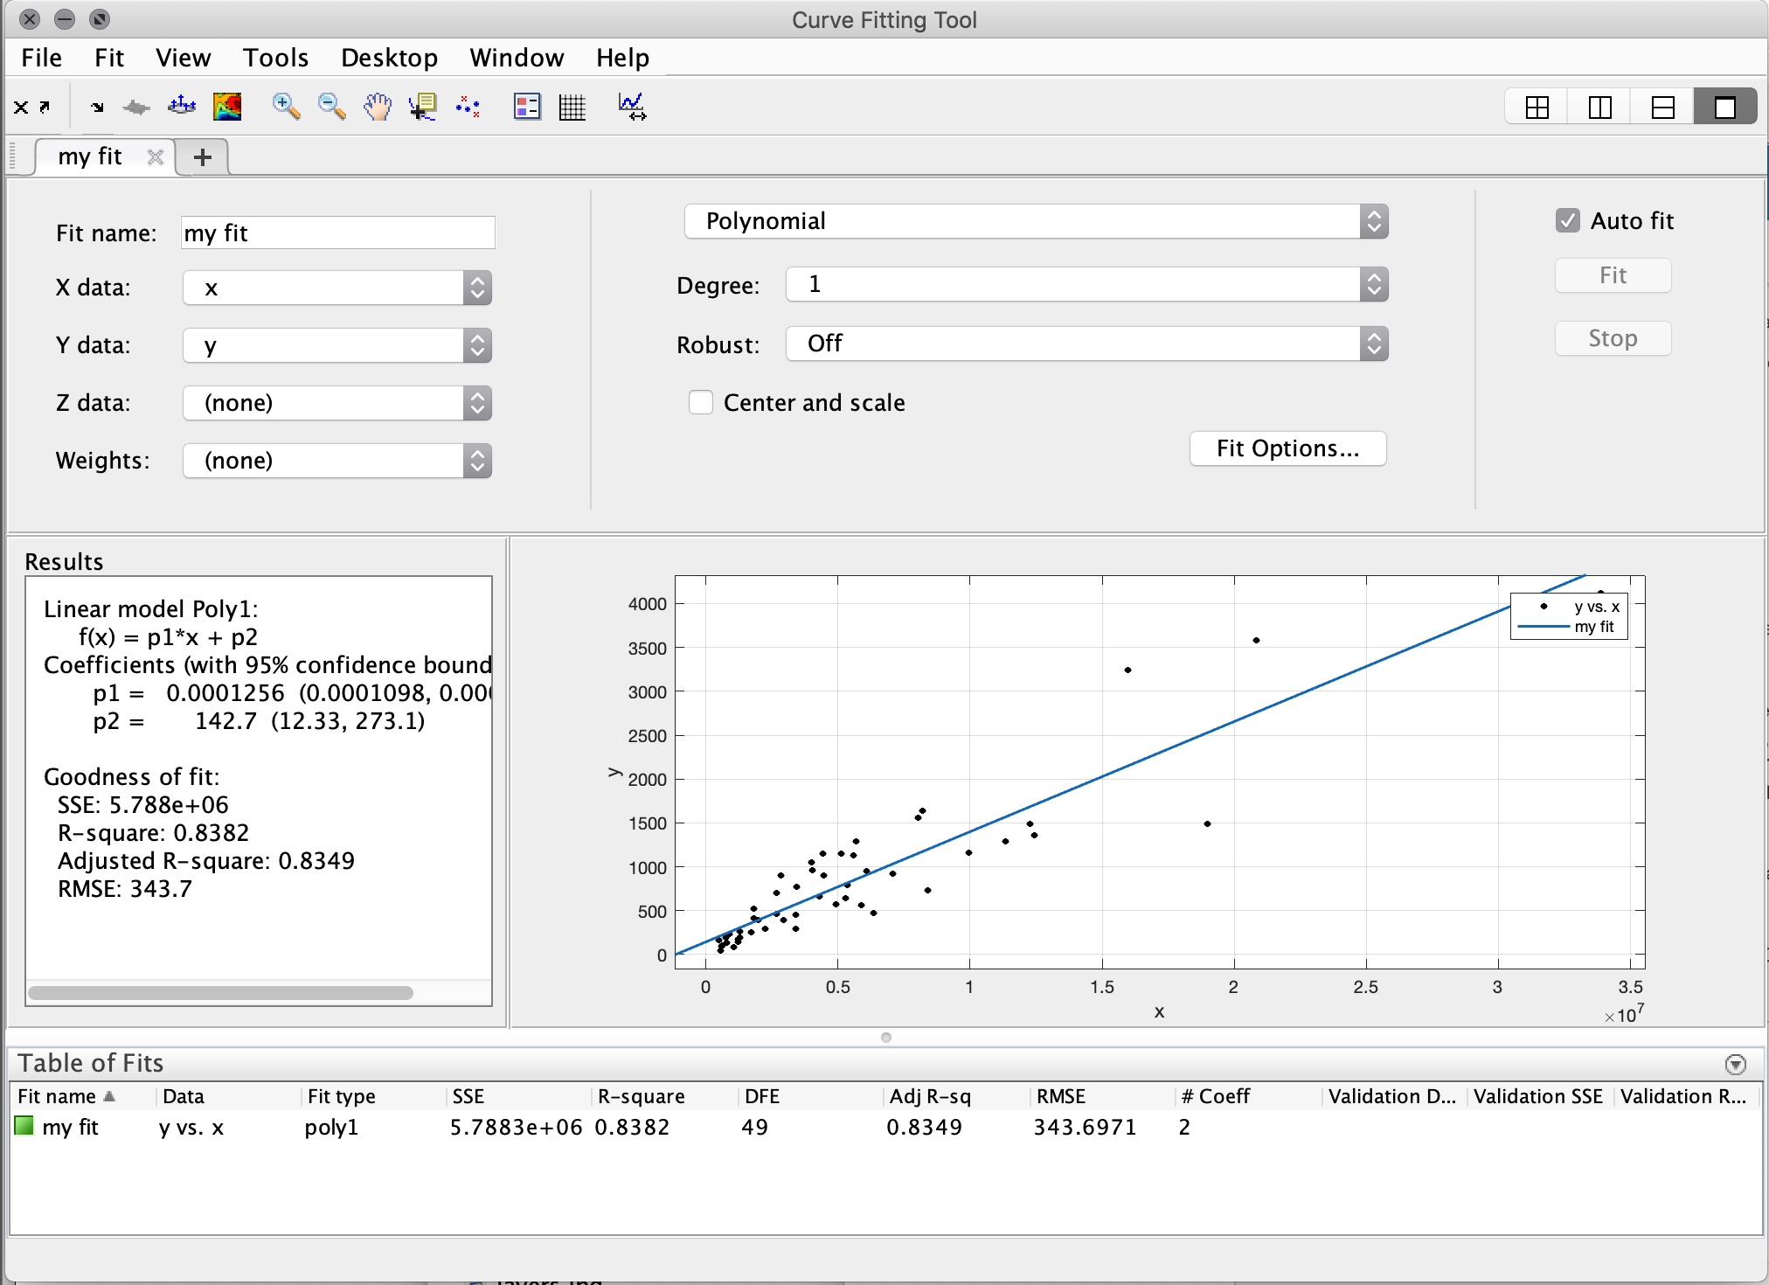
Curve fitting toolbox
Matlab also has a GUI cftool for curve fitting
Notes:
SSE: sum of squares due to error
RMSE: root mean square error

Slide 37
Add curve fitting toolbox using Add-Ons
Search for “curve fitting toolbox” and install it
You will need the credentials you used to install MATLAB

Slide 38
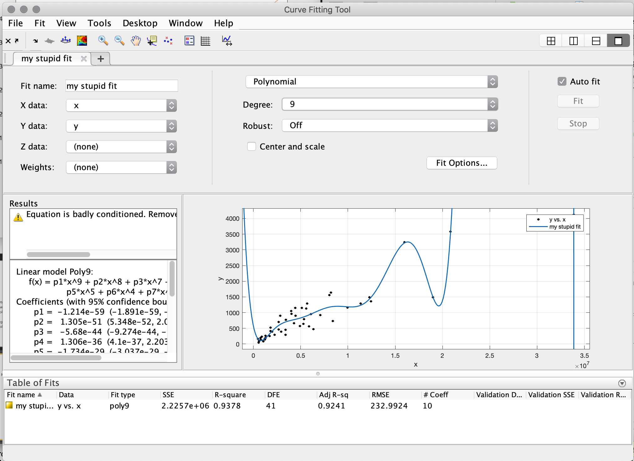
Why you have to be careful with curve fitting…
Notes:
Talk about underfit vs overfit
Robust:
LAR: least absolute residuals: extreme values have a lesser influence on the fit
Bisquare weights weights given to each data point depending on how far the point is from the fitted line

Slide 39
Next lecture
MATLAB: Program design and flow control

